Slide 1

CustomQL: Air Quality
DSCI 551 - Foundations of Data Management
Rutu Kansara
USC ID: 8368526607

Slide 2
Table of contents
01
02
03
04
05
06
Project Overview
About Dataset
SQL vs CustomQL
Functionalities
Memory Management
Demo

Slide 3
01
Project Overview

Slide 4
The aim
The goal
This project is dedicated to the creation of a custom database system designed to revolutionize data management.
Efficiency
User - Friendly
Project Significance

Slide 5
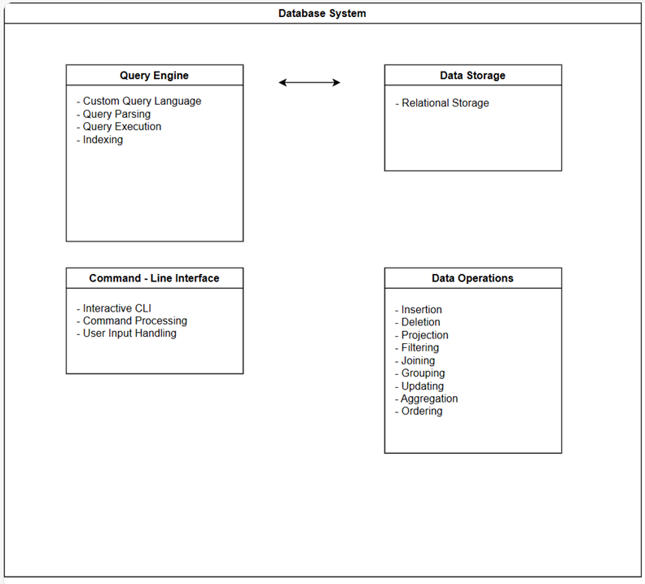
Basic Design

Slide 6
02
About Dataset

Slide 7
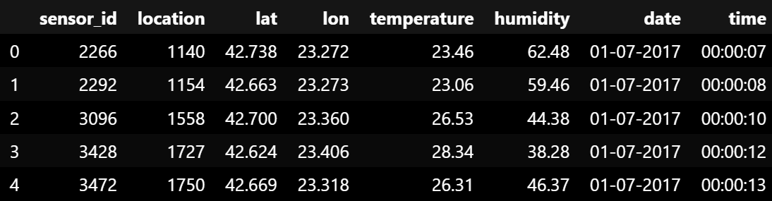
This dataset is taken from Kaggle - https://www.kaggle.com/datasets/hmavrodiev/sofia-air-quality-dataset
The dataset originates from the archive of luftdaten.info / api.dusti.xyz
The archive.luftdaten.info draws its data from outdoor sensors
The dataset consists of the following columns: sensor_id, lat, lon, temperature, timestamp, humidity, location
Link to the dataset: https://drive.google.com/file/d/1vDr2IP4vhM6wALxWCXu1L46Xw7lieijz/view?usp=drive_link

Slide 8
03
SQL vs CustomQL

Slide 9
Description | SQL | CustomQL
Retrieve all columns from the specified table | SELECT * FROM Table | FETCH ALL FROM Table
Retrieve specific data based on a specified condition | SELECT column1 FROM table1 WHERE condition | FETCH column1 FROM table1 FOR condition
Updating columns with a specified value based on a condition | UPDATE table1 SET column1 = value1 WHERE condition | MODIFY table1 SET column1 = value1 FOR condition
Remove data from the table | DELETE FROM table1 | REMOVE FROM table1
Define and create a new table | CREATE TABLE | DEFINE TABLE
Remove a table | DROP TABLE | REMOVE TABLE
Add new data to the table | INSERT INTO | ADD INTO

Slide 10
04
Functionalities

Slide 11
Functionalities
The code supports a custom query language with commands such as
DEFINE TABLE
INSERT INTO
REMOVE FROM
REMOVE TABLE
UPDATE TABLE
DISPLAY TABLES
ORDERING (INC/DEC)
AGGREGATE
GROUP BY
JOIN

Slide 12
05
Memory Management

Slide 13
Memory management is crucial for the efficient execution of programs, particularly when dealing with large datasets or when processing multiple queries
Memory profiling → memory_profiler and @profile
Chunked data loading → read_csv_in chunks
Memory-Optimized Table

Slide 14
06
Demo

Slide 15
Thanks!
rkansara@usc.edu
+1 551 362 9991

